Slide 1




OUT PASS MANAGER
PROJECT BY
DWARAGESH C
SRIDEV B

Slide 2




INTRODUCTION
The Outpass Manager is a digital platform developed to streamline the process of requesting and approving outpasses for hostel students. Instead of the traditional manual system, this application allows students to submit outpass requests online, which are then sent directly to the warden for approval. Once the warden reviews and accepts the request, an outpass is automatically generated in PDF format for the student to download and use. This system ensures a faster, more efficient, and transparent process, reducing paperwork, saving time, and enhancing overall hostel management.

Slide 3



EXISTING PROBLEM
Manual outpass process is time-consuming and inefficient.
Students need to physically approach the warden for approval.
Increased chances of miscommunication and delays in approval.
Difficulty in maintaining and retrieving records of past outpasses.
Lack of transparency in the approval process.
Higher administrative burden on wardens and hostel staff.
Risk of security issues due to improper tracking of student movement.

Slide 4




PROPOSED SOLUTIONS
Digitized Outpass Request System: Implement an online platform where students can easily request outpasses, reducing manual effort and delays.
Warden Approval Workflow: Enable wardens to receive, review, and approve/reject requests instantly through a secure dashboard.
Automated PDF Generation: Upon approval, generate a downloadable PDF outpass to ensure authenticity and easy verification.

Slide 5

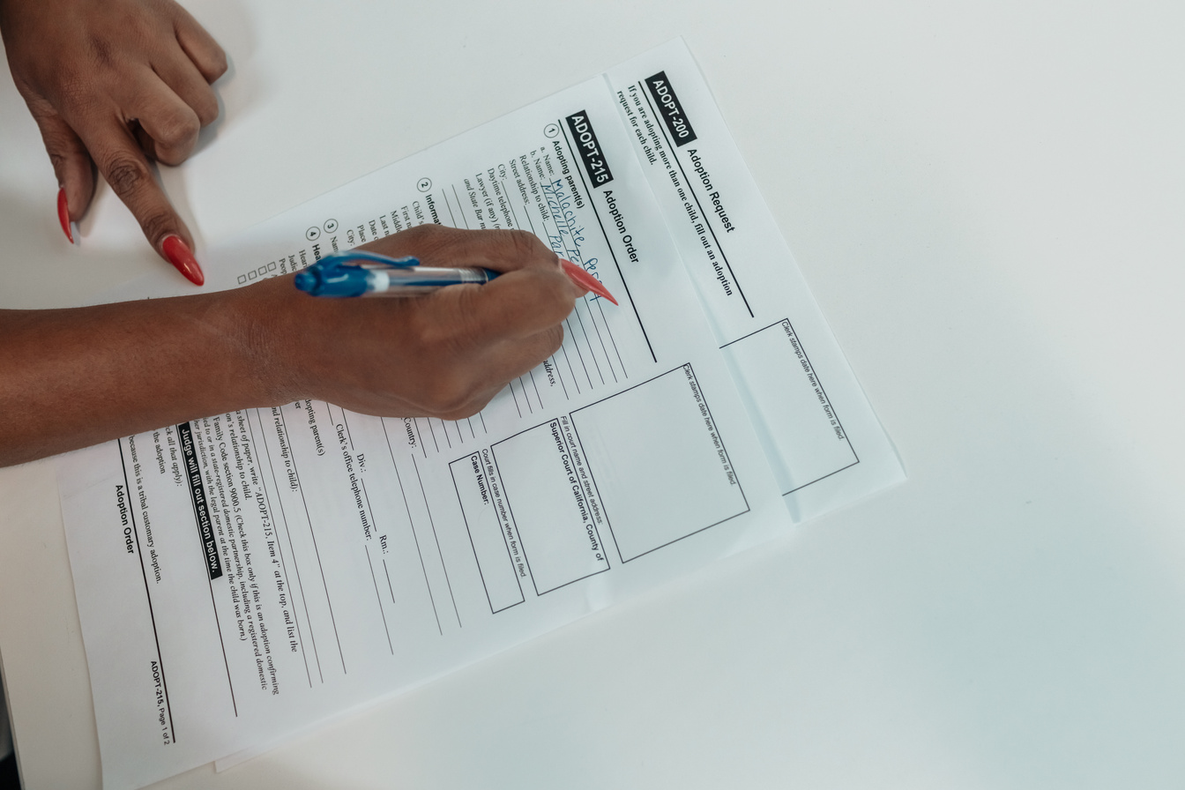

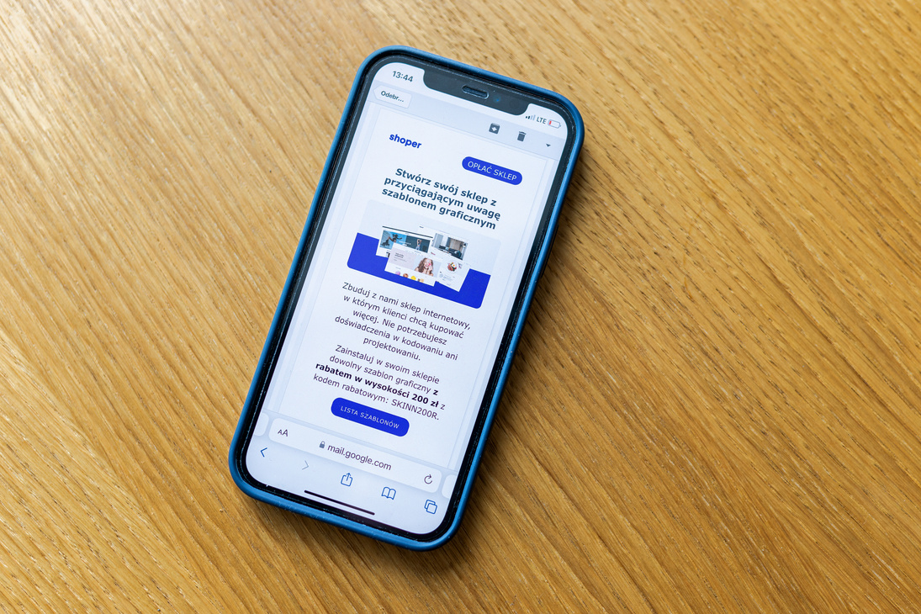
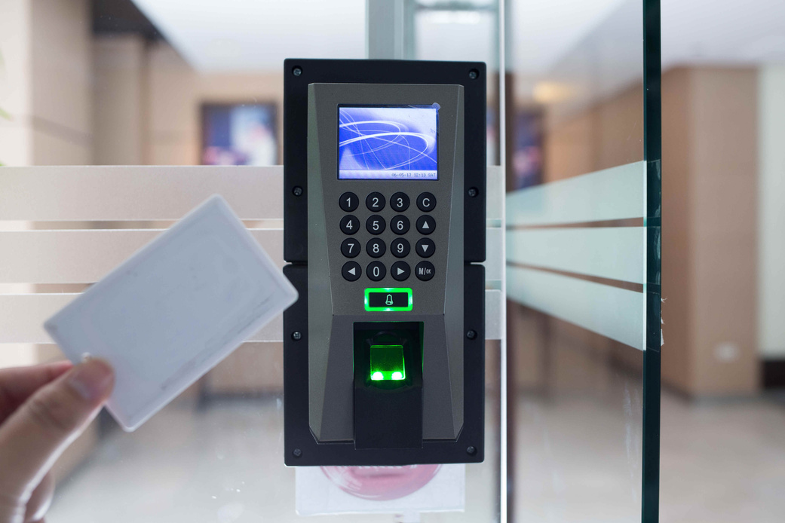
KEY FEATURES
Outpass Request &Approval –
Live Status Dashboard -
Allows users to apply for outpasses and get approvals from designated authorities.
Displays real-time status of all outpass applications with filtering options.
Better UI –
Role-Based Access –
Proper alerts for application status, pending approvals, and return deadlines.
Provides different access levels for students, staff, and admins based on their roles.

Slide 6






Process Steps
Outpass Request Submission:
Review & Approval:
Student Access to Outpass:
The warden reviews the details and either approves or rejects the request based on hostel policies.
The student can download or view the approved outpass and use it when exiting the hostel.
Students fill in details such as date, time, reason, and duration of leave, and submit the request.
Student Login :
Warden Notification:
PDF Outpass Generation:
Students log in to the system using their credentials to access the outpass request form.
The warden receives a real-time notification of the student’s outpass request on their dashboard.
If approved, a digitally generated PDF outpass is created with the student's details and approval status.

Slide 7







THANK'S FOR WATCHING

